Slide 1
Appunti per ostetriche e non solo
Collegio delle Ostetriche della provincia di Mantova
Green Park Mantova, Strada Circonvallazione Sud 21/B
Mantova
25 marzo – 8/22 aprile – 6/20 maggio 2017

Slide 2

LA DIAGNOSI PRECOCE
NELLE NEOPLASIE GINECOLOGICHE
Gabrio Zacchè
Mantova, 06/05/2017

Slide 3
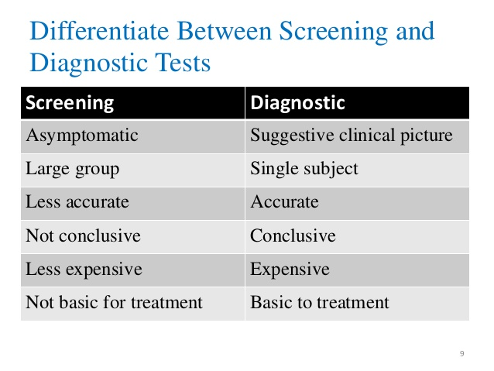

Slide 4
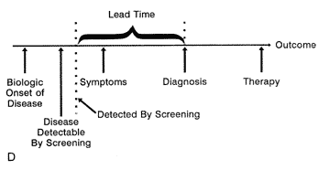

Slide 5
OVARIAN CANCER AND EARLY DIAGNOSIS

Slide 6
The «silent killer», asymptomatic
in early stages.
75% diagnosed in advanced stage disease.

Slide 7
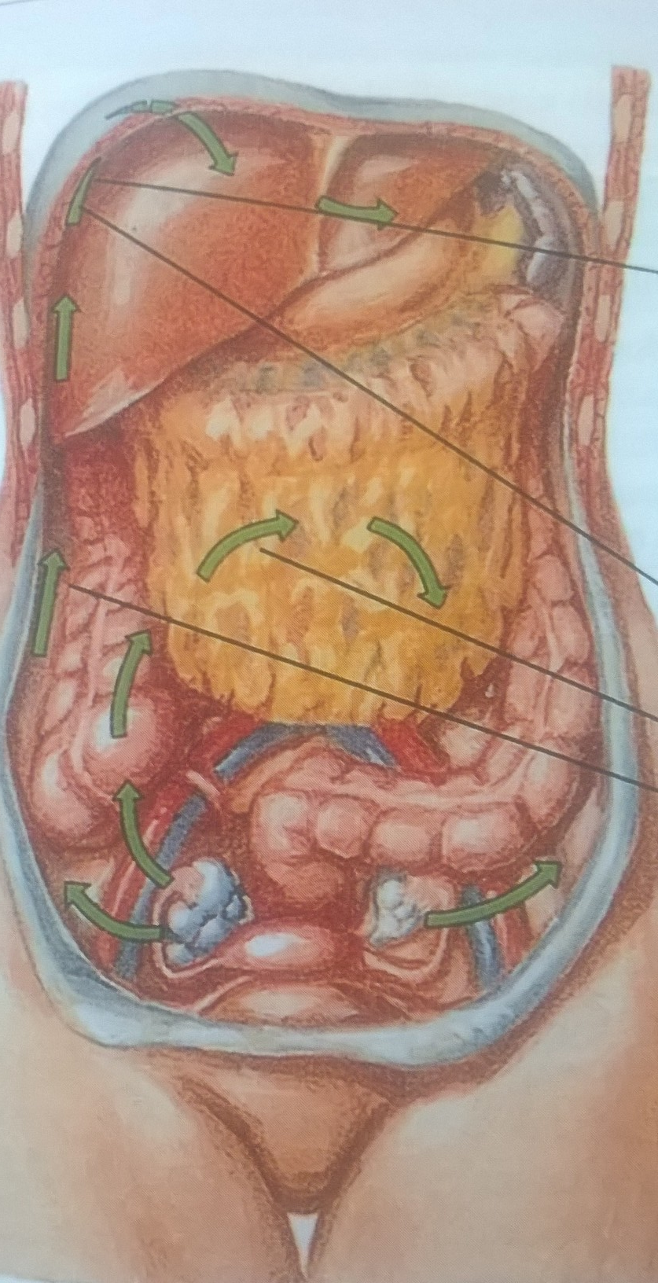


Slide 8
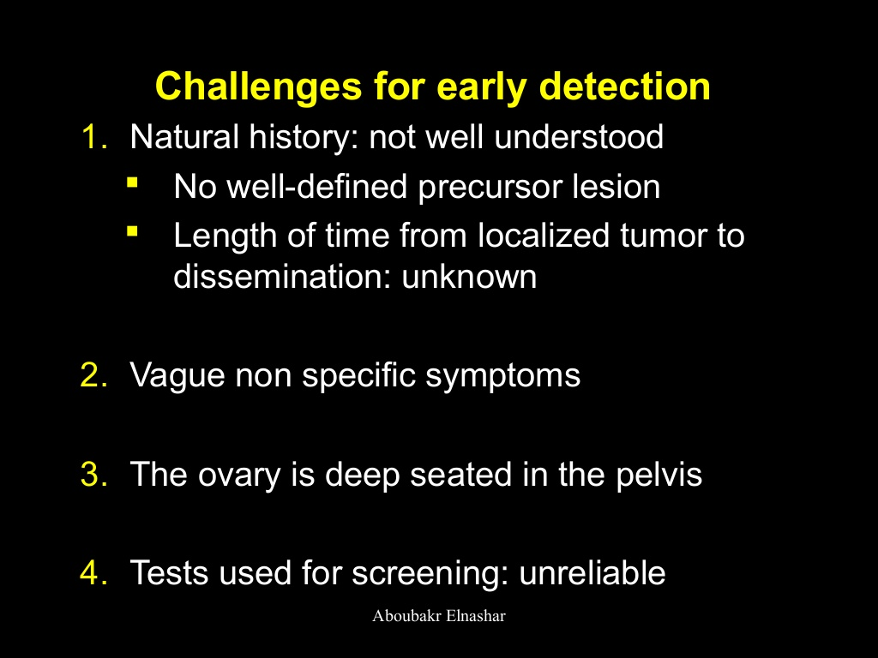

Slide 9
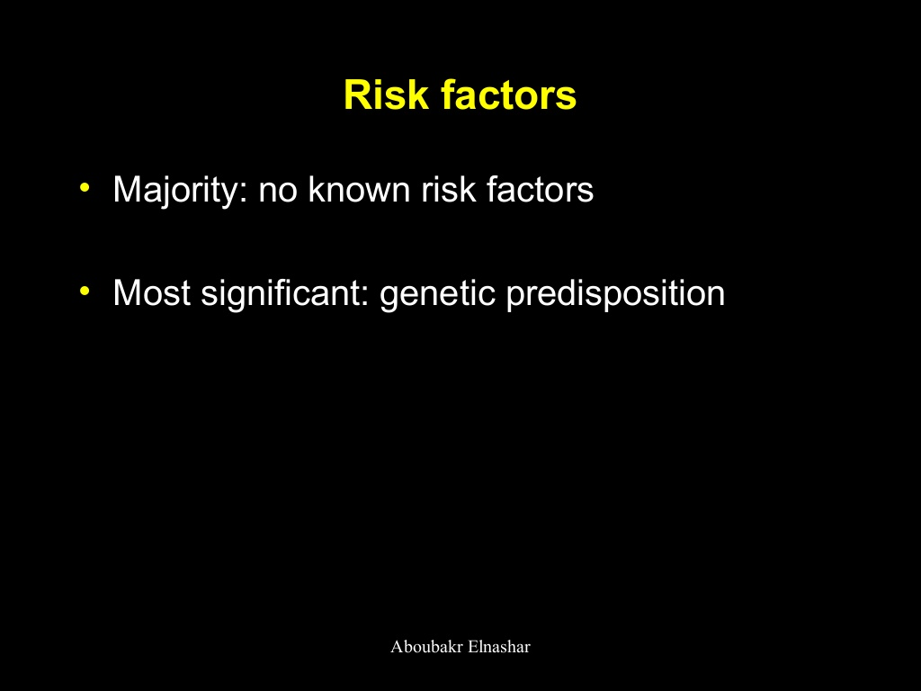

Slide 10
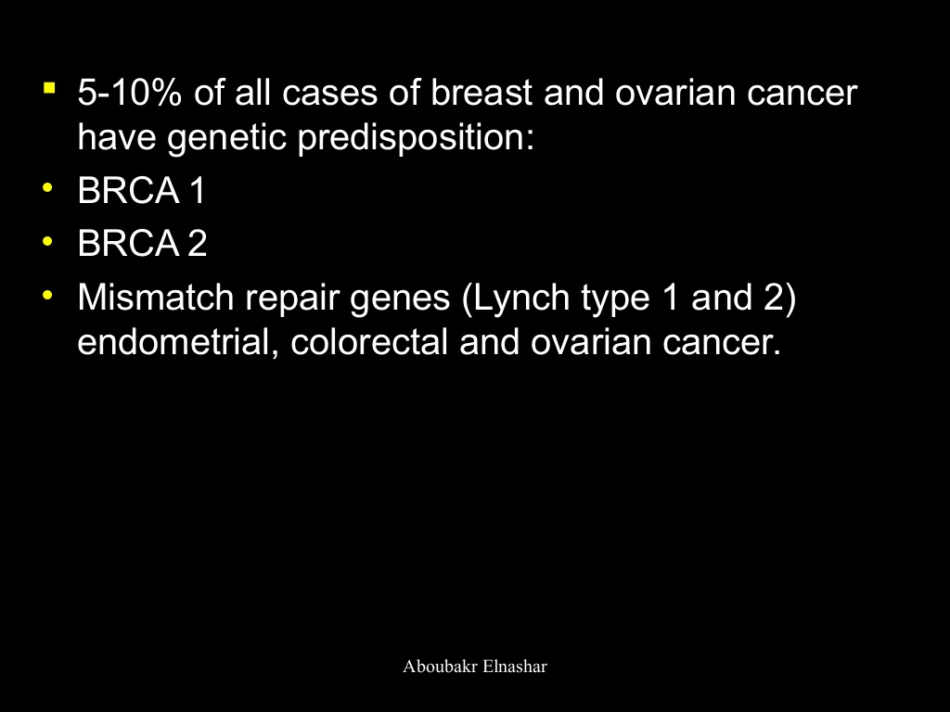
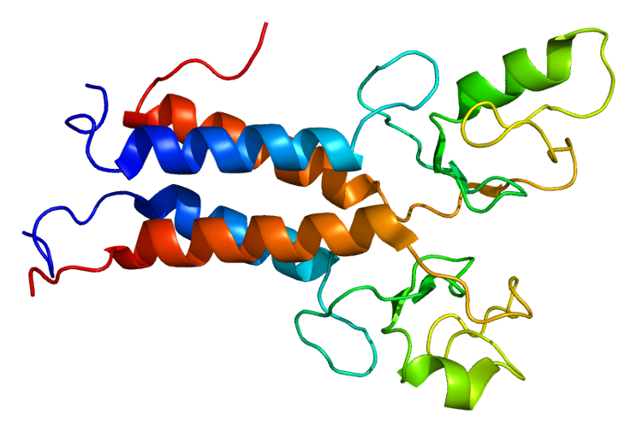

Slide 11
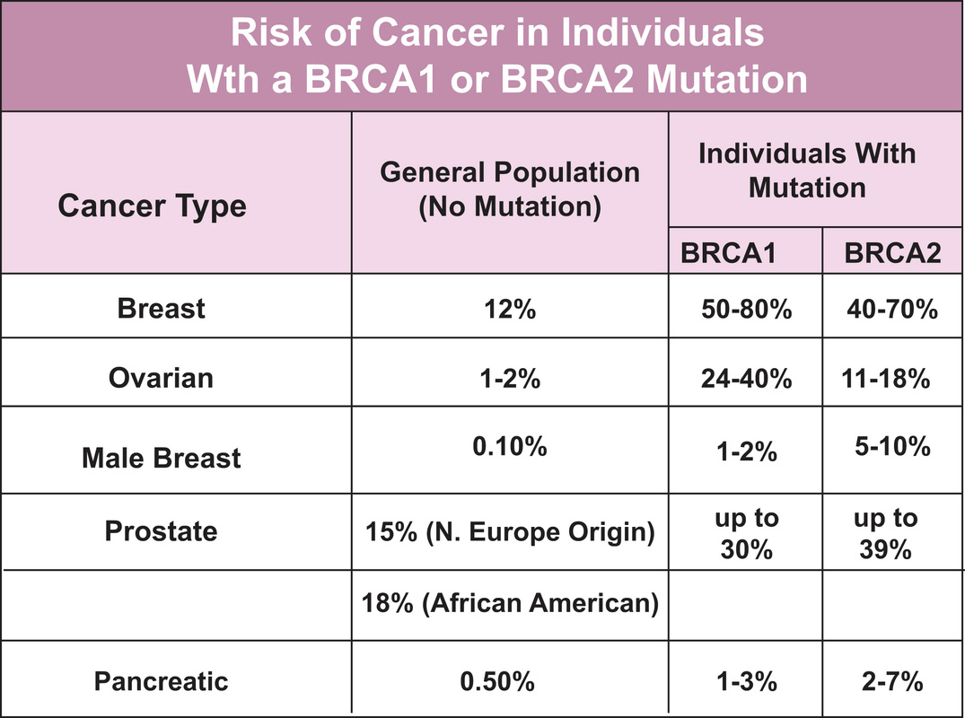

Slide 12
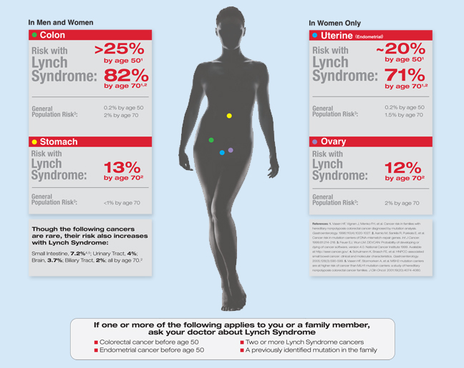

Slide 13
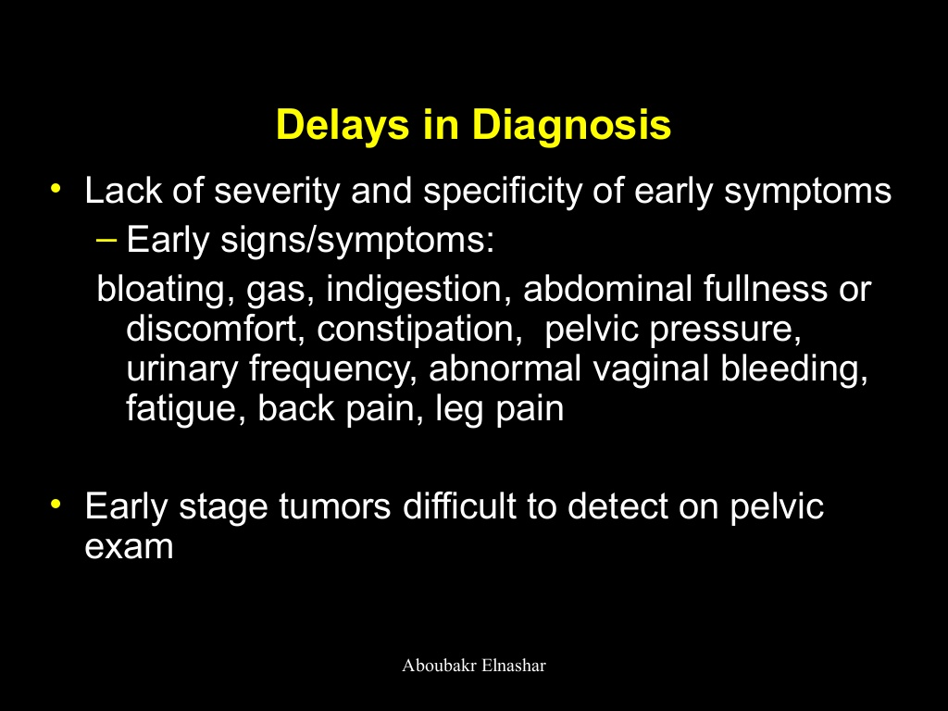

Slide 14
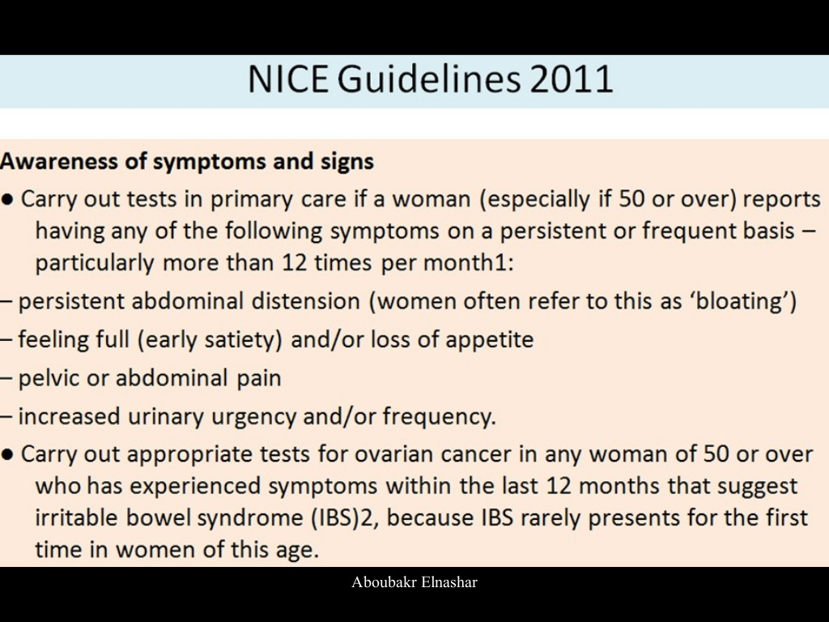

Slide 15
Strategies
° US: TV and TA
° Color- flow Doppler
° Ca 125
° Other tumor markers

Slide 16
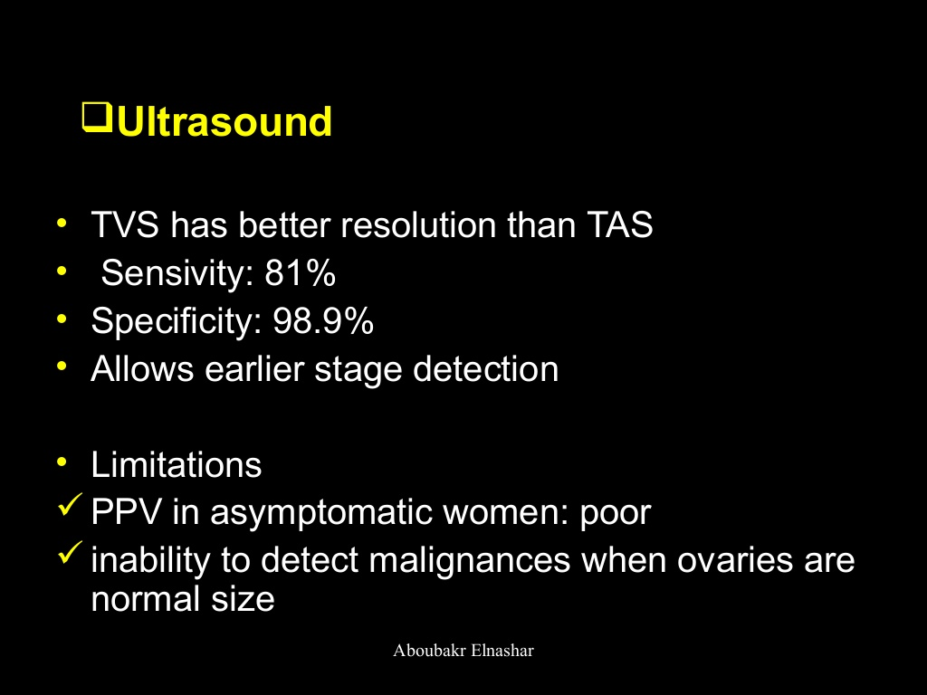

Slide 17
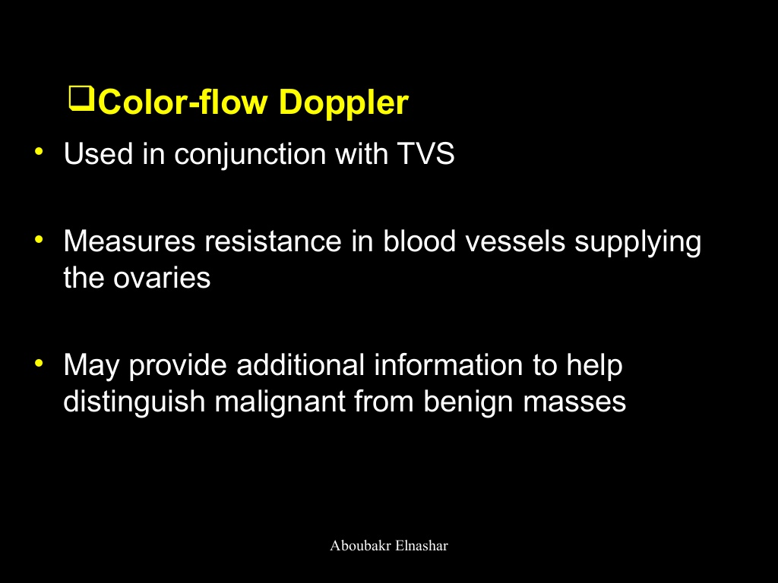

Slide 18
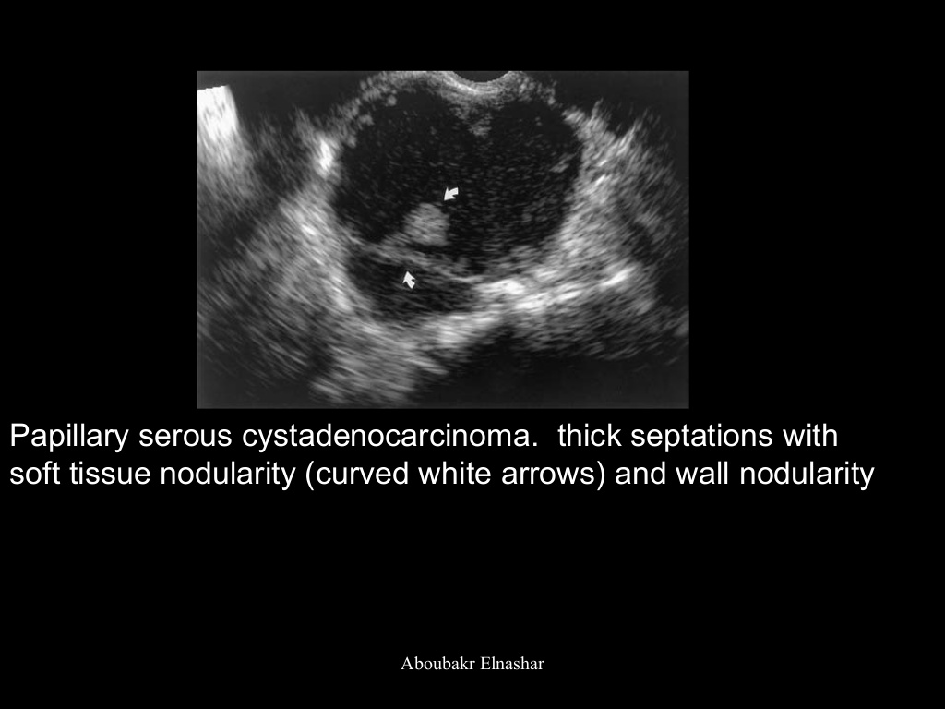

Slide 19
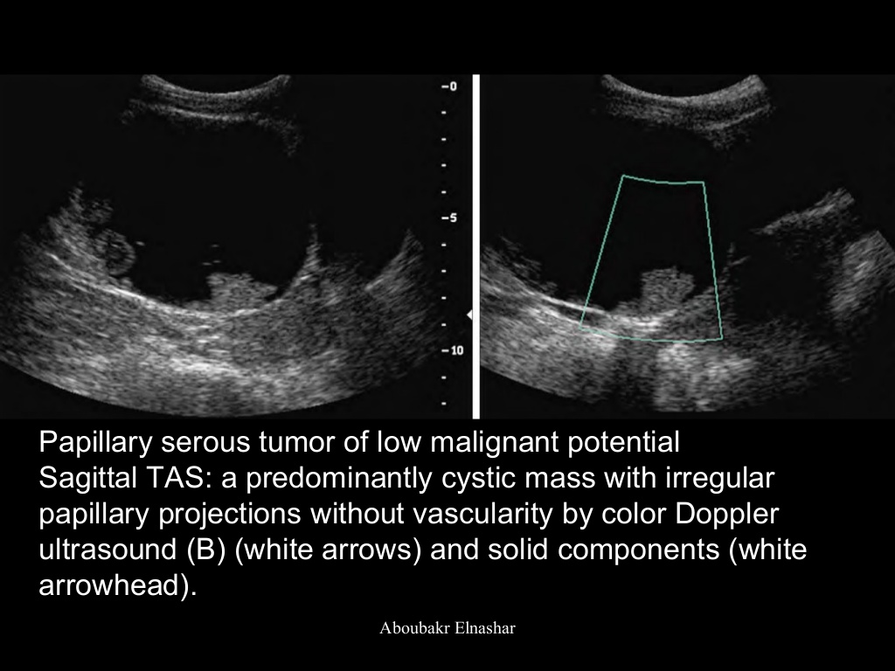

Slide 20
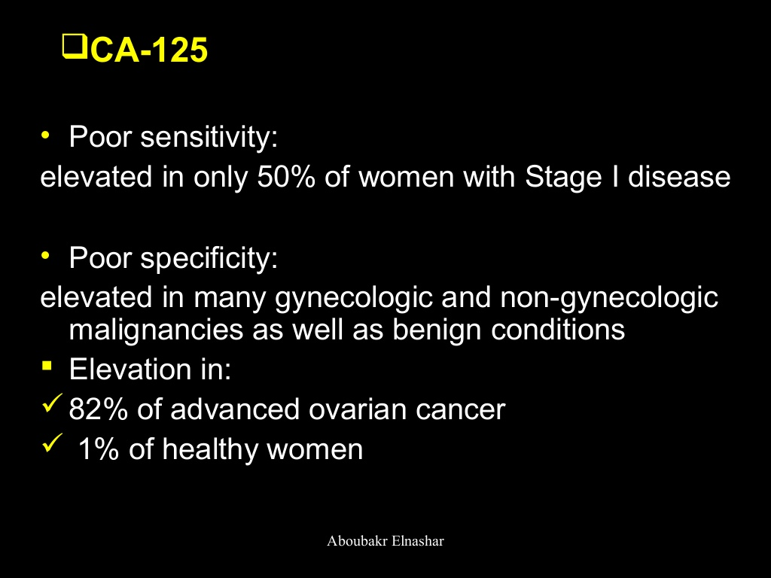

Slide 21
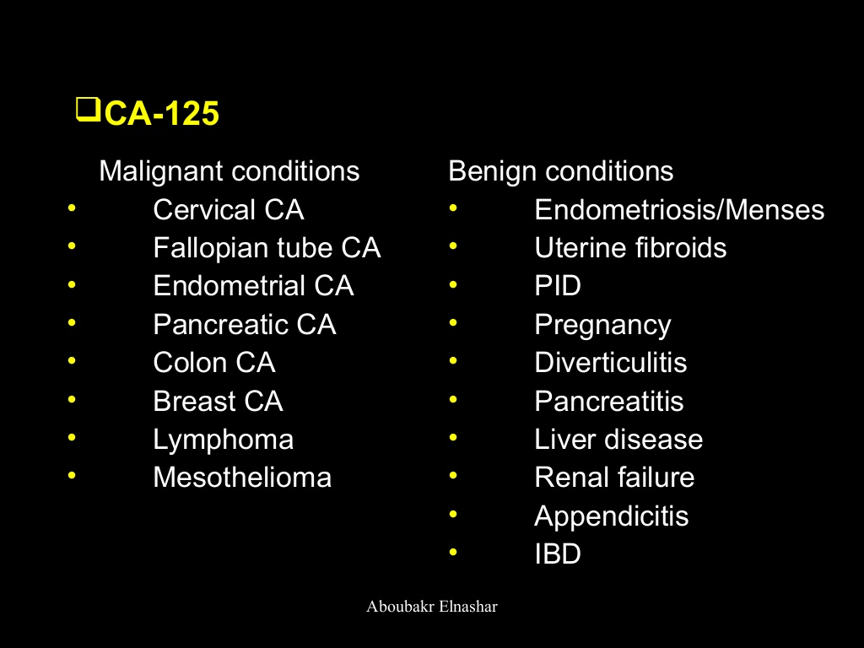

Slide 22
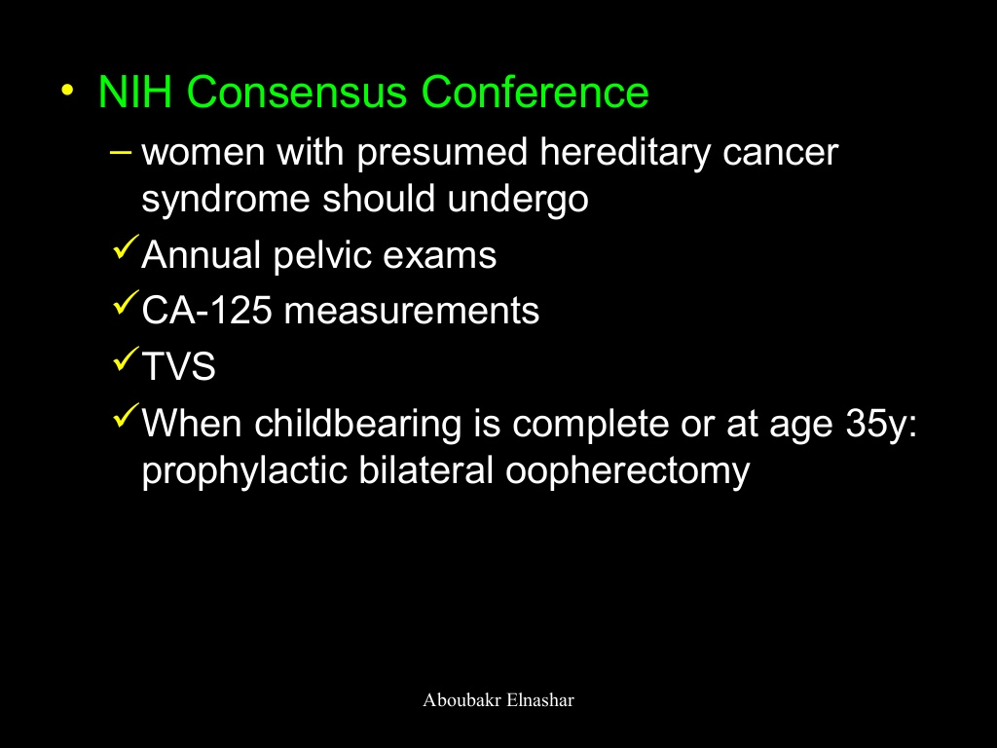

Slide 23
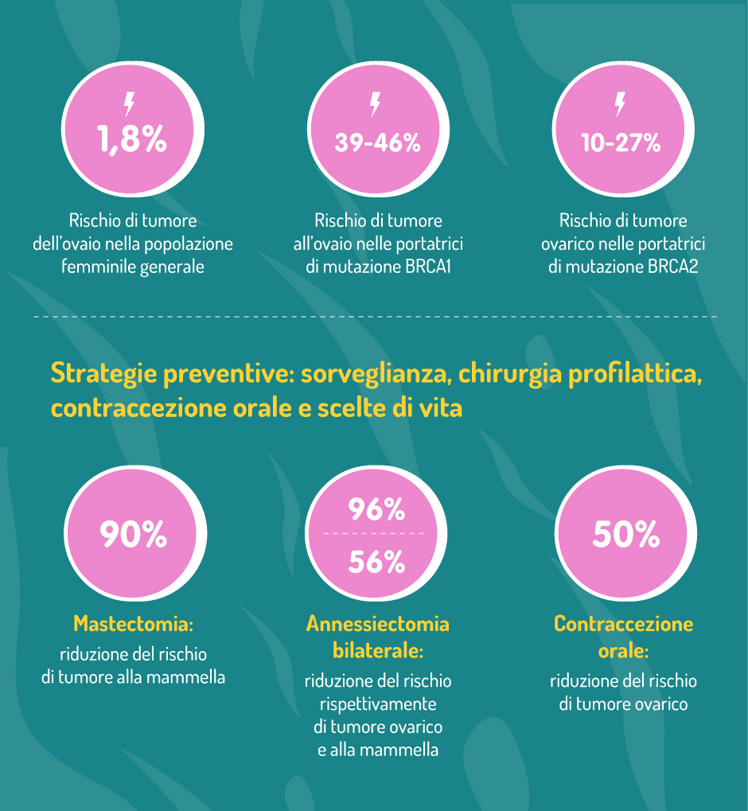

Slide 24
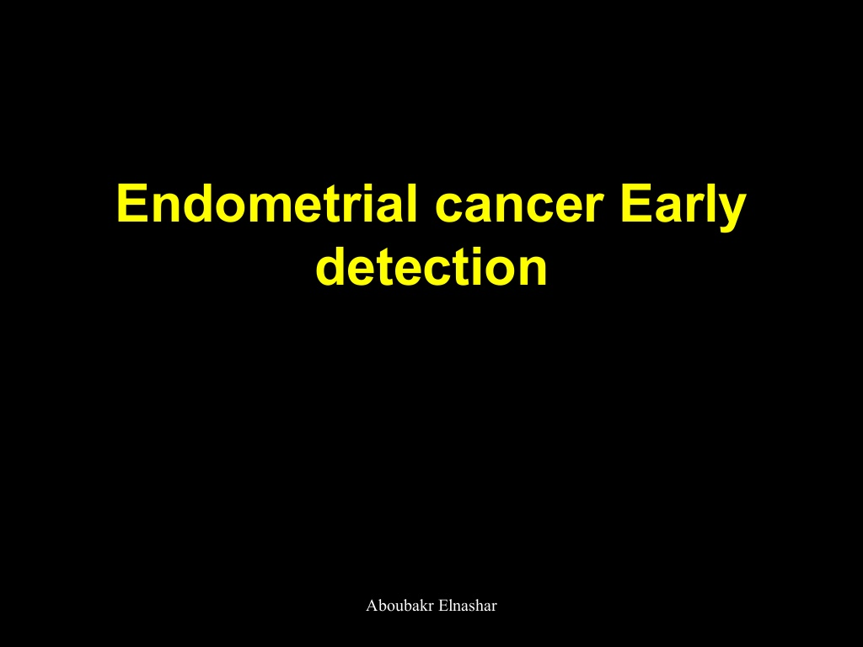

Slide 25
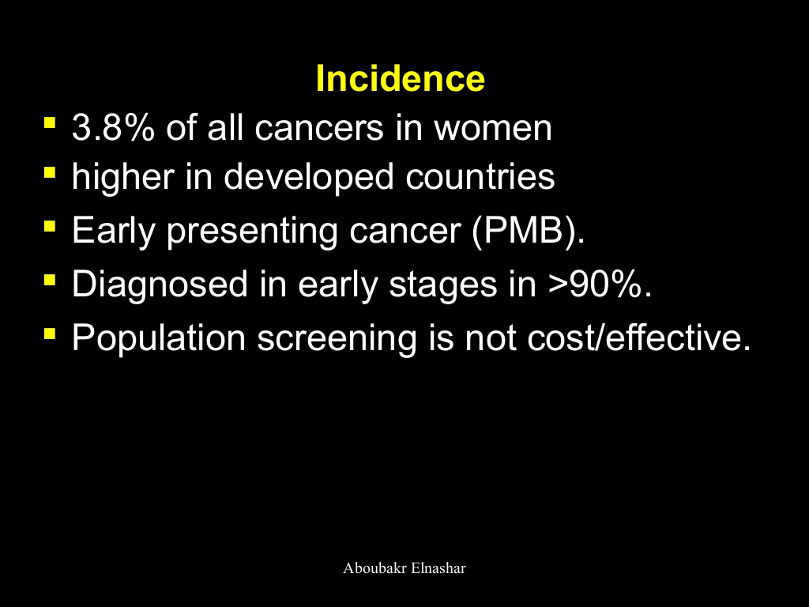

Slide 26
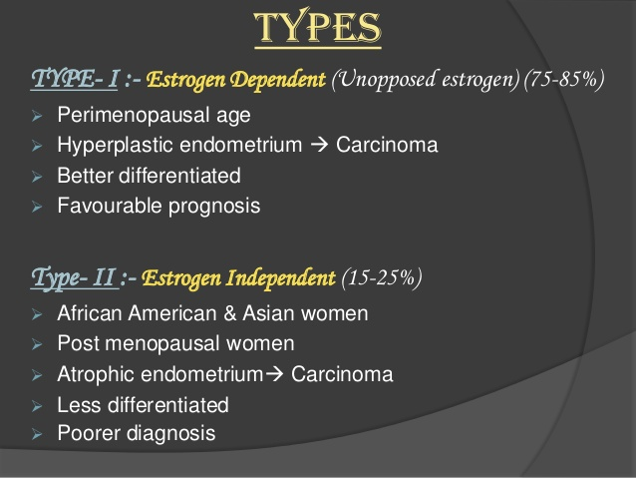

Slide 27
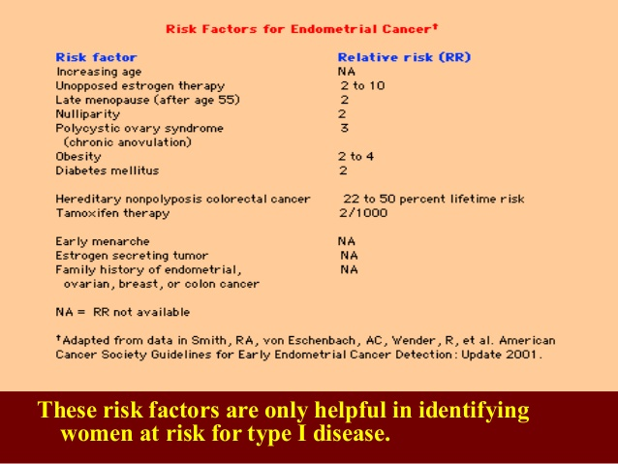

Slide 28
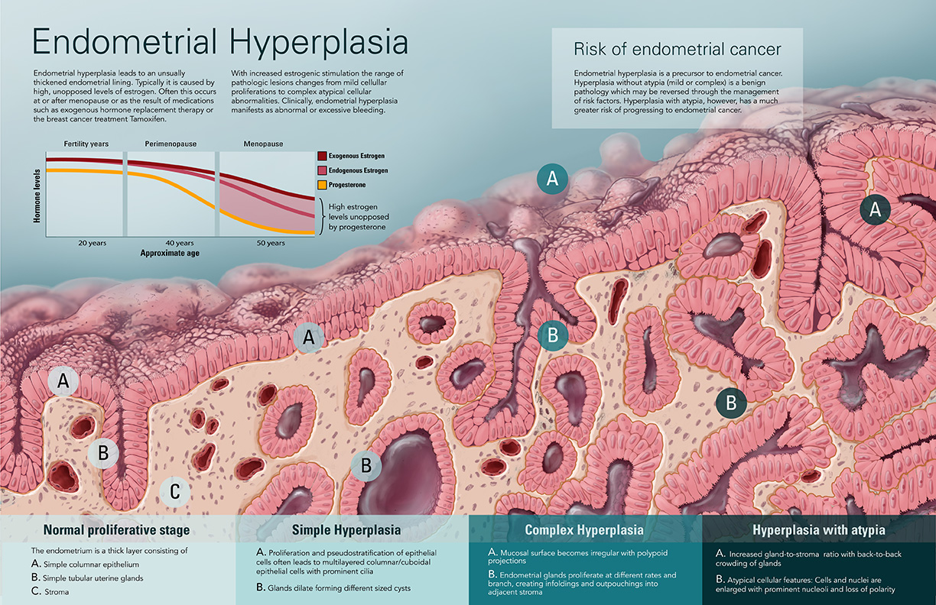

Slide 29
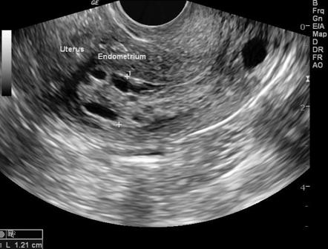
ETV: endometrial hyperplasia

Slide 30
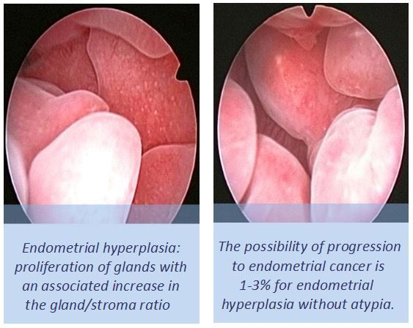
Hysteroscopy

Slide 31

Classic symptom
Abnormal uterine bleeding
Particular suspicion:
° postmenopausal women
° > 40 with high-risk factors
Series of patiens > 70 years ,
diabets or nulliparity, white PMB:
80% Hyperplasia/Carcinonoma

Slide 32
Modalities of early detection
Detection stage I > 70%
° ACOG and SGO do not recommend routine
screening.
° ACS only >35 years women at risk for Lynch 2
(women whit Lynch syndrome have
risk of developing endometrial cancer 40- 60%)
° Pap smear is inadequate

Slide 33
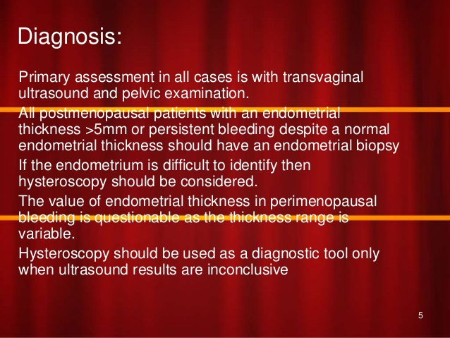

Slide 34

1. TVS, colore doppler, hysterosonography
° Helpfull in evalutation vaginal bleeding
° Helpfull in follow up of high risk women
In a meta-analisys endometrial thickness > 5 mm in postmenopausa detect 96% of cancers and have 39% false – positive rate.

Slide 35
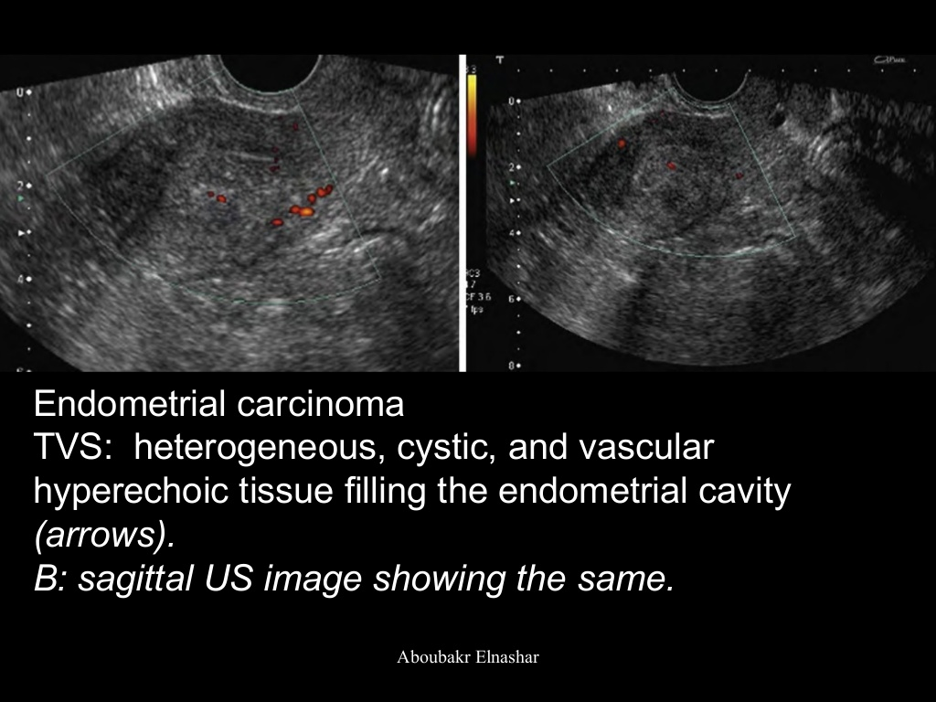

Slide 36
2. Endometrial sampling
° Less invasive
Aspiration curettage accuracy 90%
35% of samplers insufficient for diagnosis
° More invasive
D & C accuracy ( classical gold standard)
91-99%

Slide 37
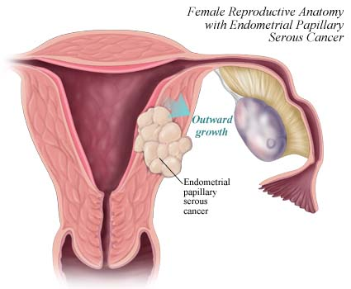
Difficult diagnosis in particular cases

Slide 38
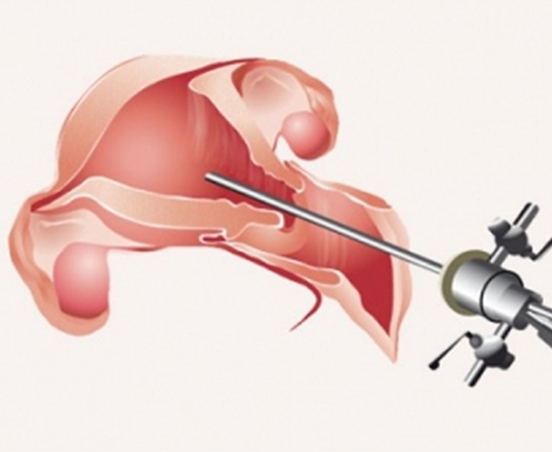
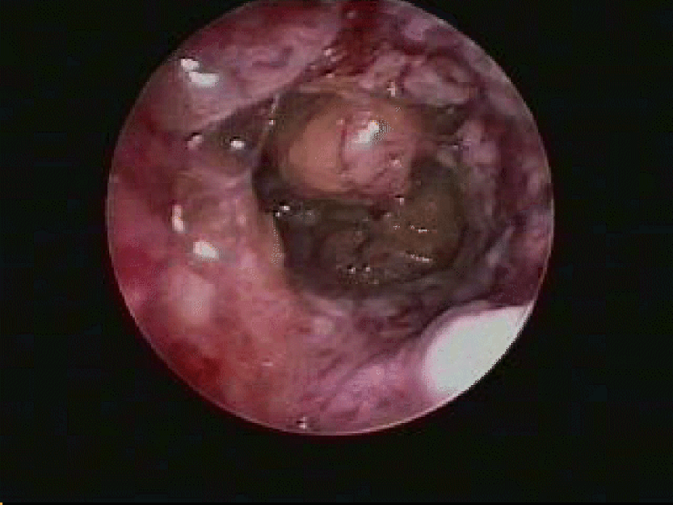
3. Hysteroscopy
Important adiuvant to D & C

Slide 39
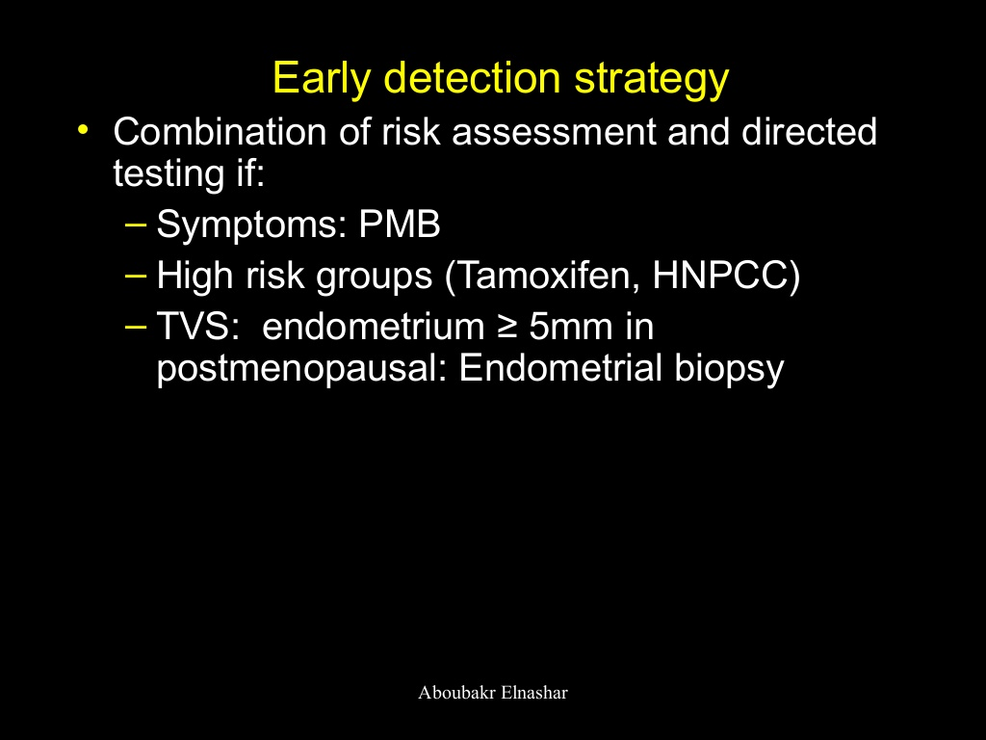

Slide 40
CERVICAL CANCER EARLY DETECTION

Slide 41
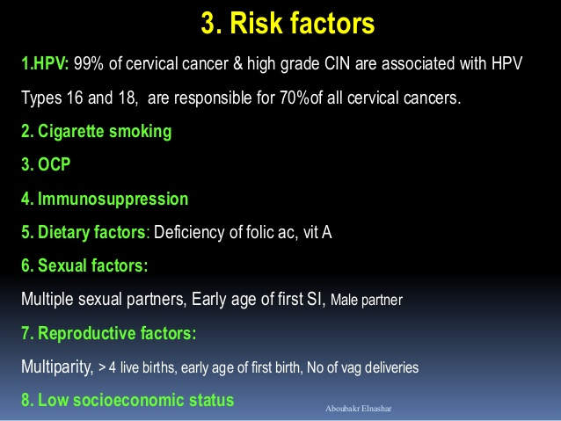

Slide 42
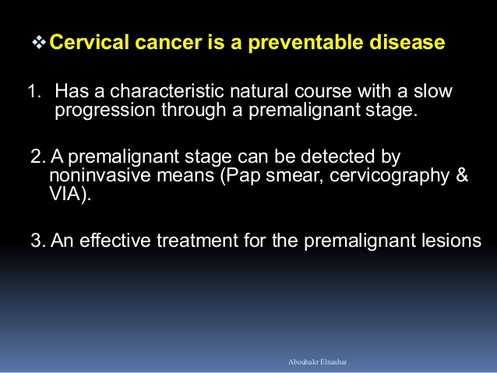

Slide 43
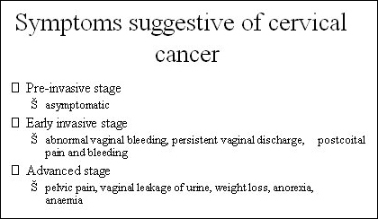

Slide 44
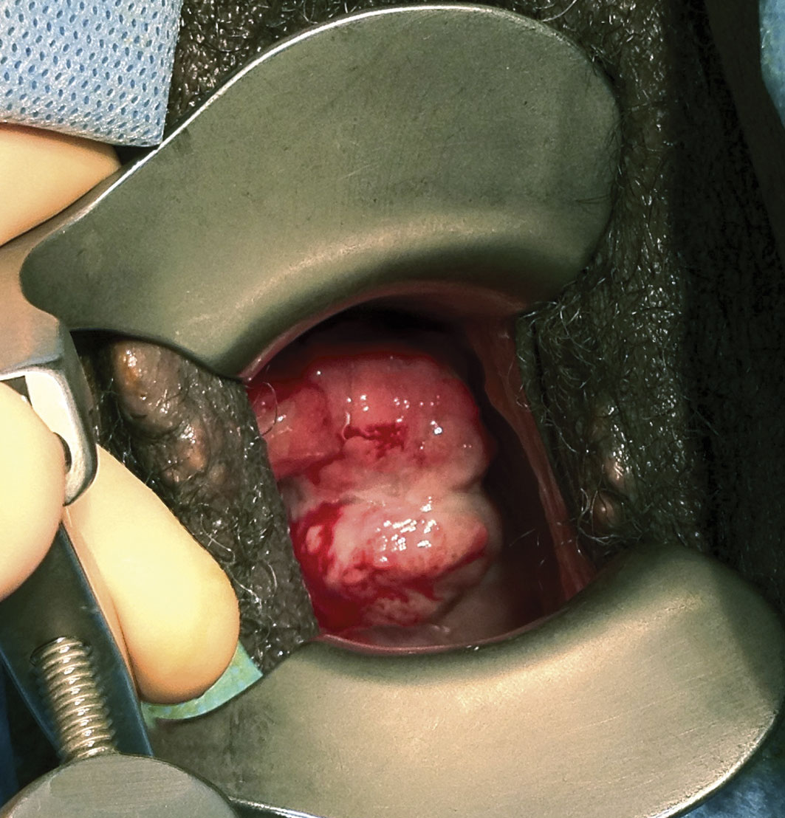


Slide 45
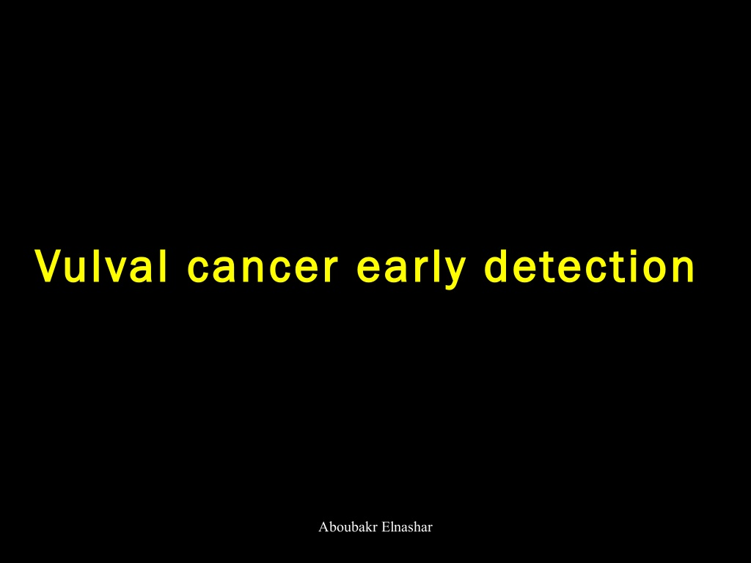

Slide 46
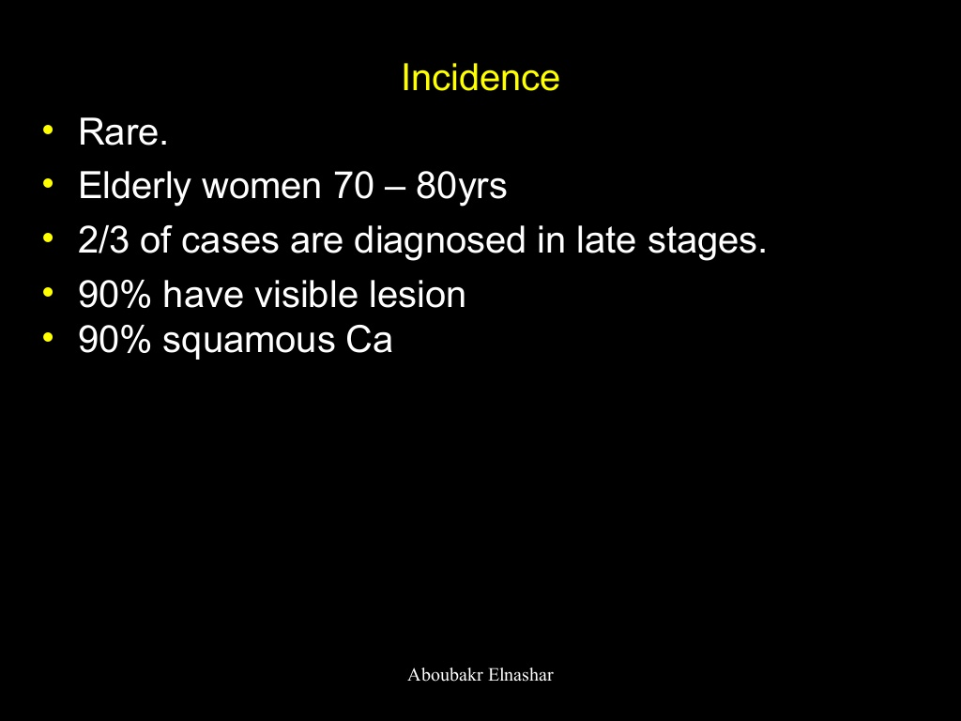

Slide 47
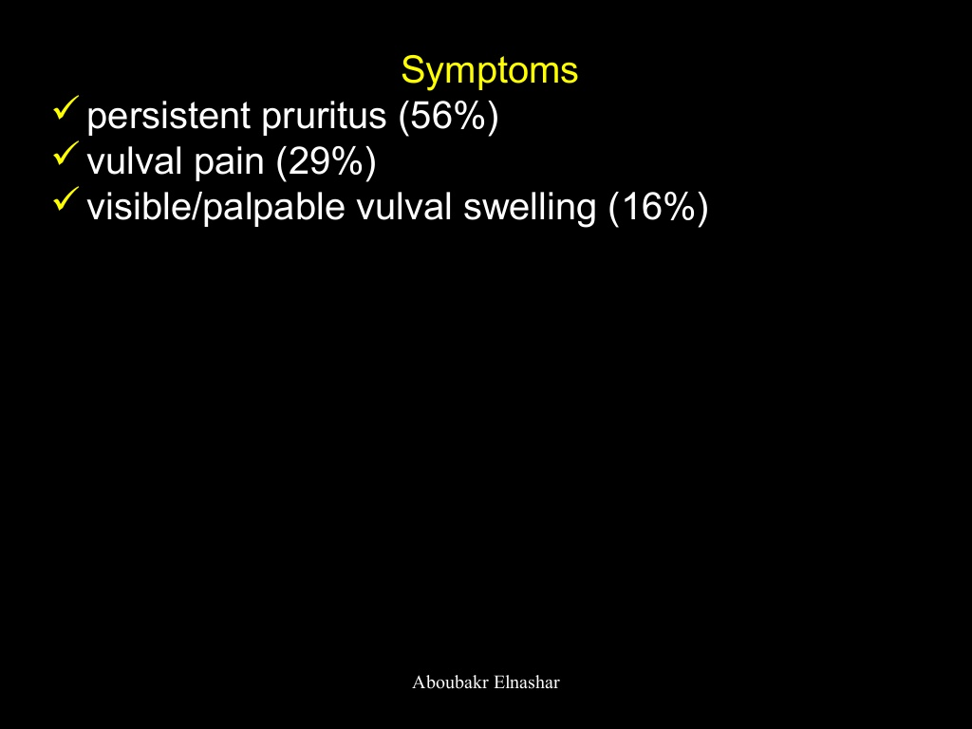
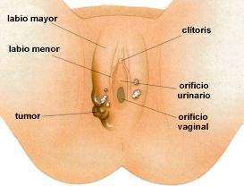

Slide 48
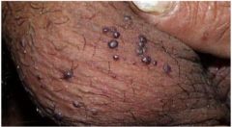
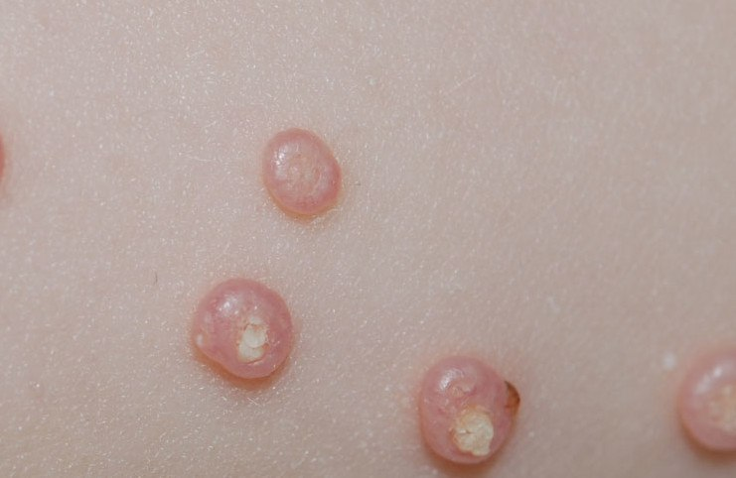
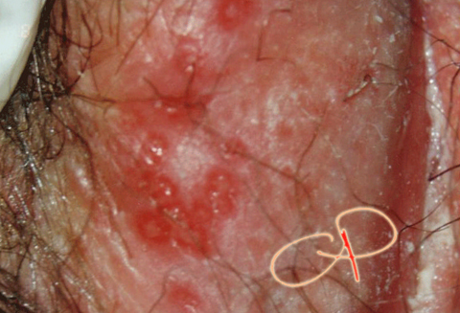
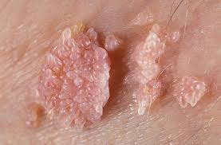

Slide 49
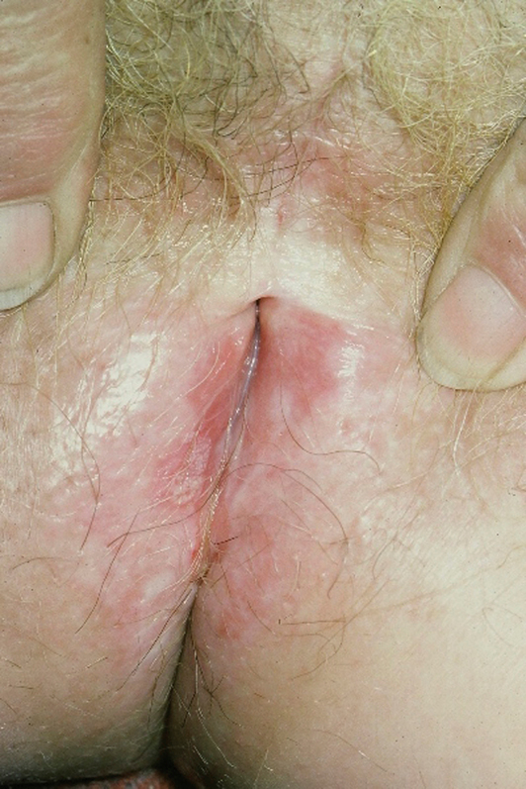

Slide 50
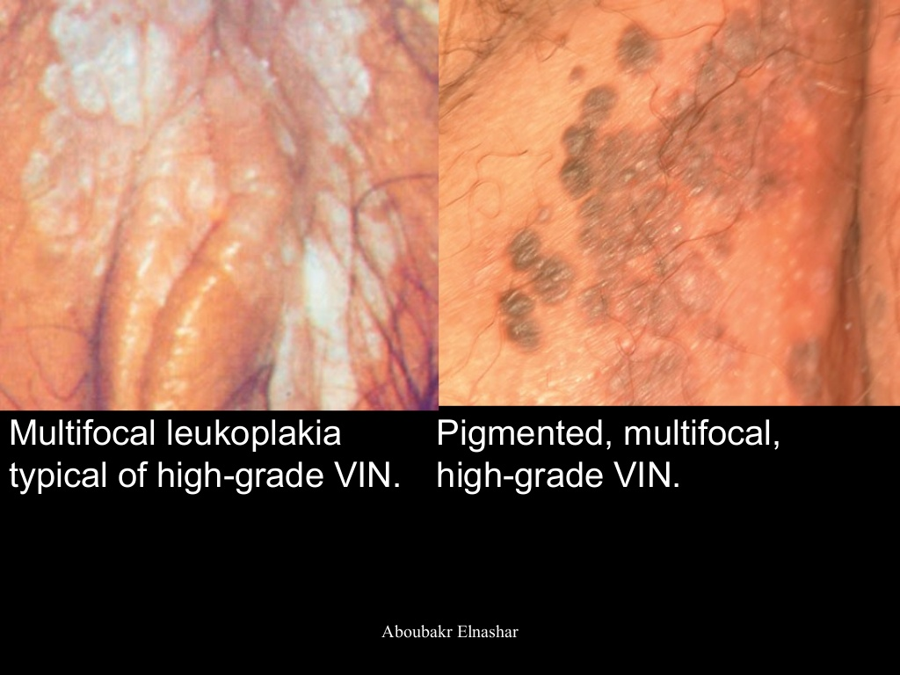

Slide 51
2015 ISSVD Terminology of Vulvar Squamous Intraepithelial Lesions
- Low grade squamous intraepithelial lesion ( Flat condyloma or HPV effect )
- High grade squamous intraepithelial lesion ( VIN usual Type )
Più frequente. Associata ad HPV (specie il 16), donne più giovani
20-30% precursore del ca.
Vulvar intraepithelial neoplasia, differentiated -Type
Meno frequente. Donne anziane. Non associate ad HPV. 70-80%
precursore ca.

Slide 52
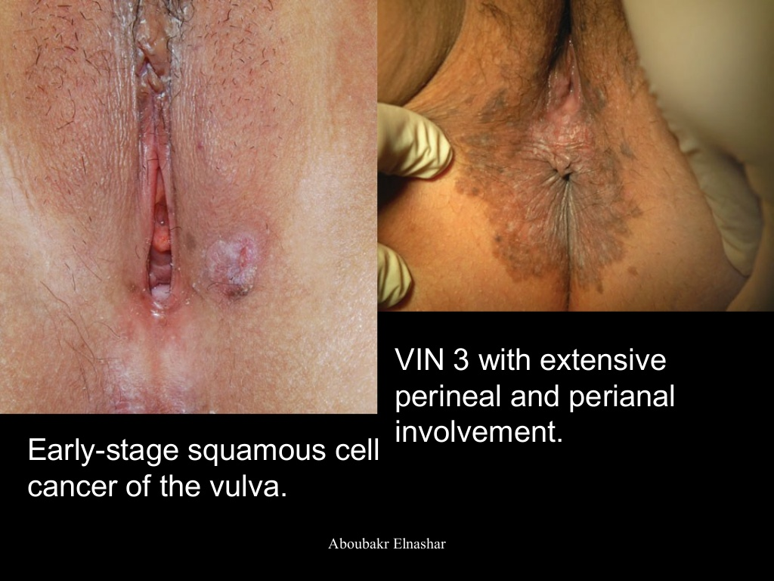

Slide 53
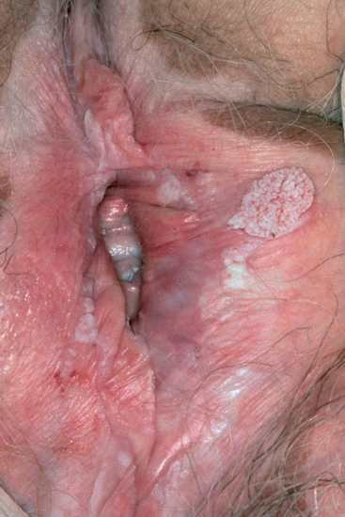

Slide 54
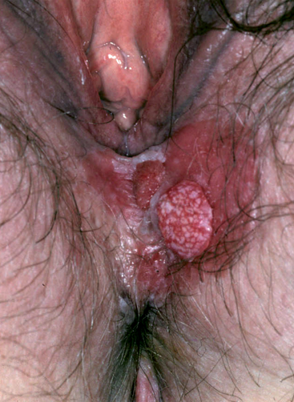

Slide 55
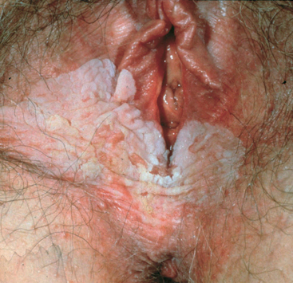

Slide 56


Slide 57


Slide 58


Slide 59

S
U
M
M
A
R
Y

